Slide 1
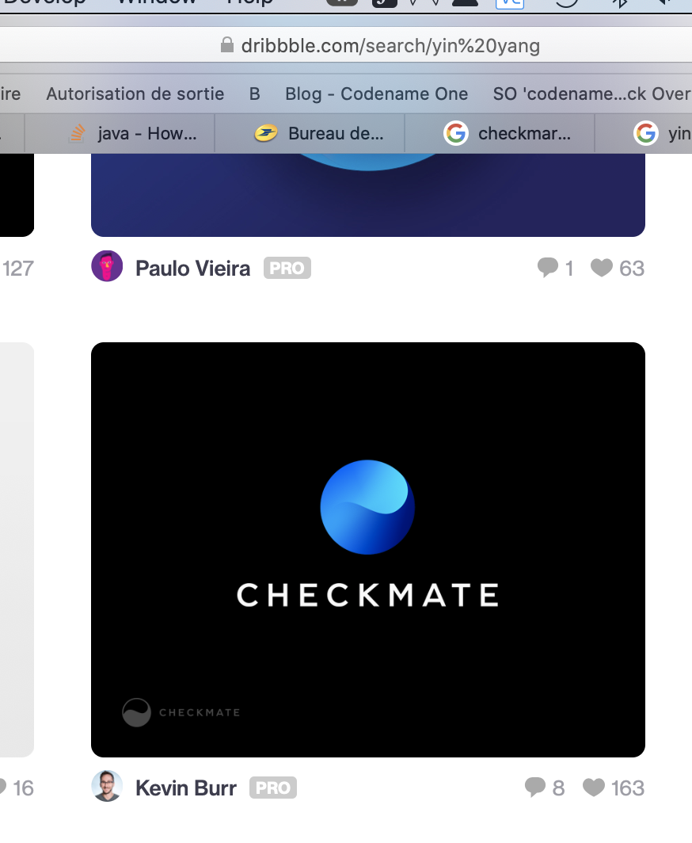



Slide 2
Specificiations
Business users, so eg solid colors
Pro-looking, so simple and essential
Subtle
Yin Yang or similar, signaling mastership, harmony, calm, stress-free, professionalism, predictability, transformation to something better/continuous improvement
Elegant

Slide 3







Slide 4
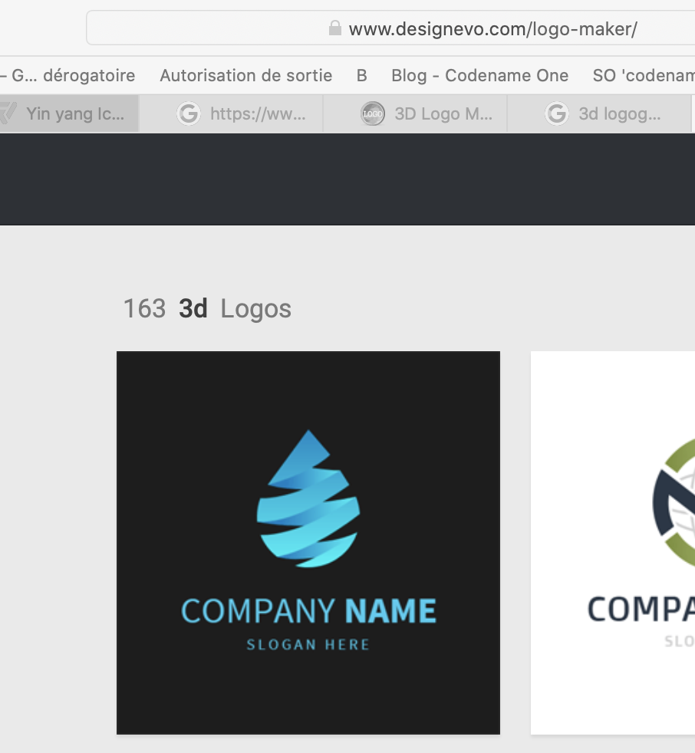

Slide 9
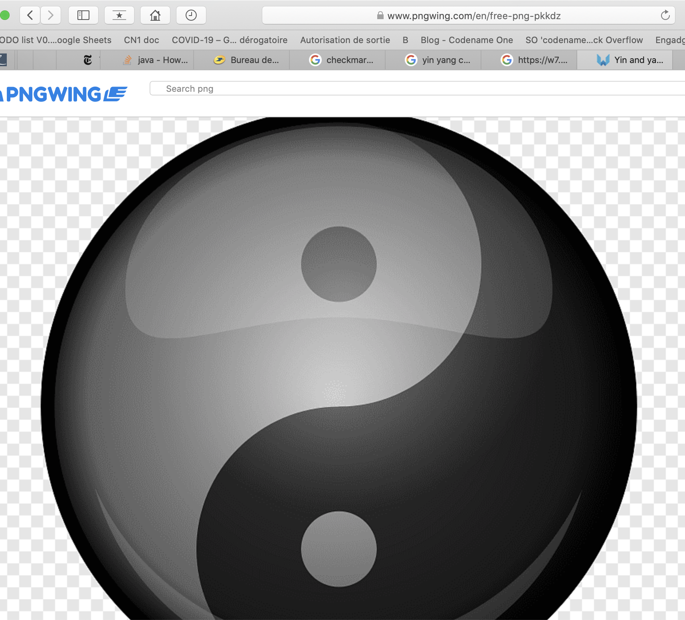

Slide 10
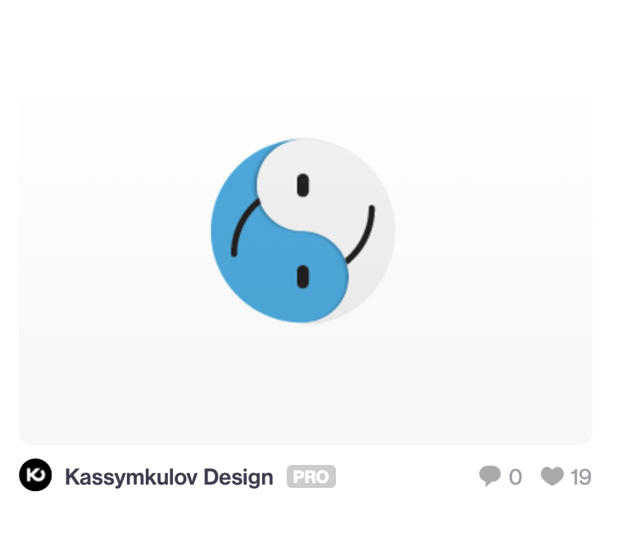
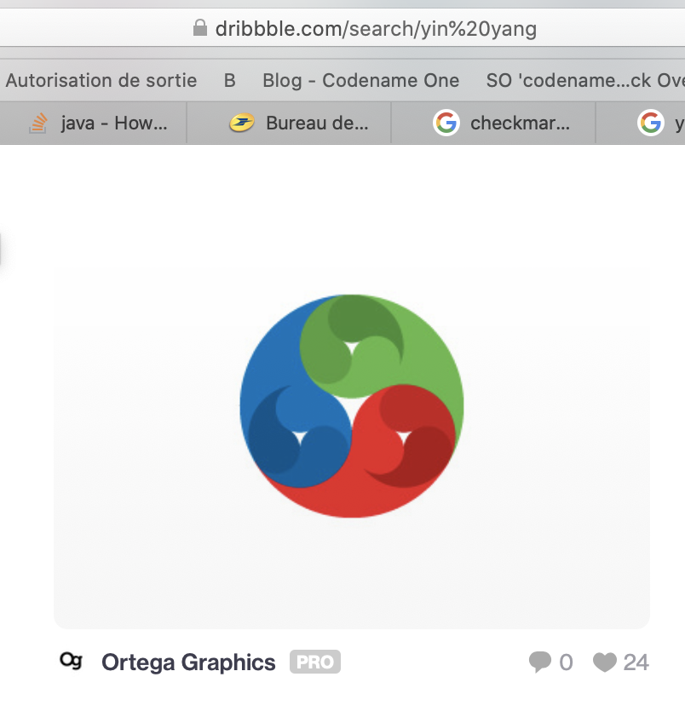
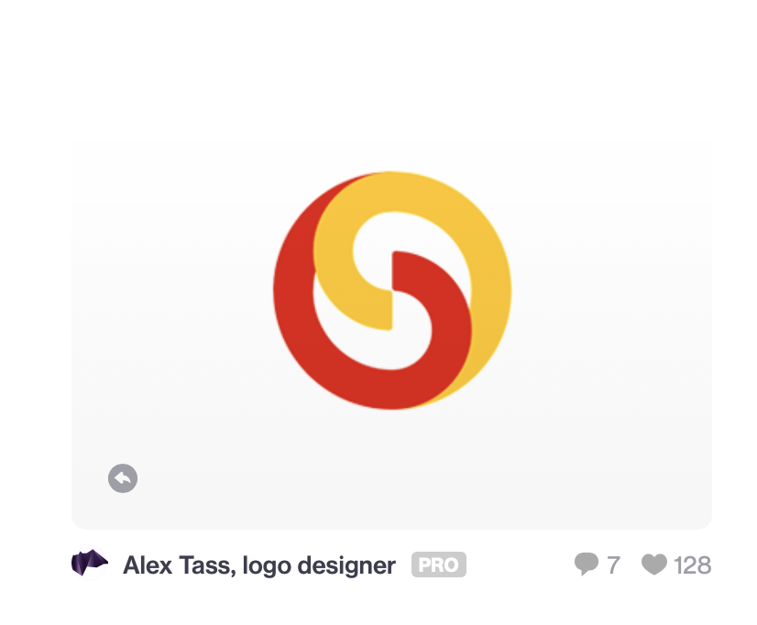
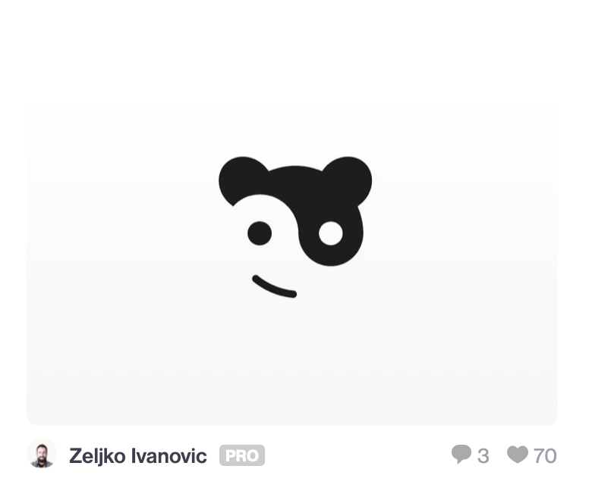

Slide 11
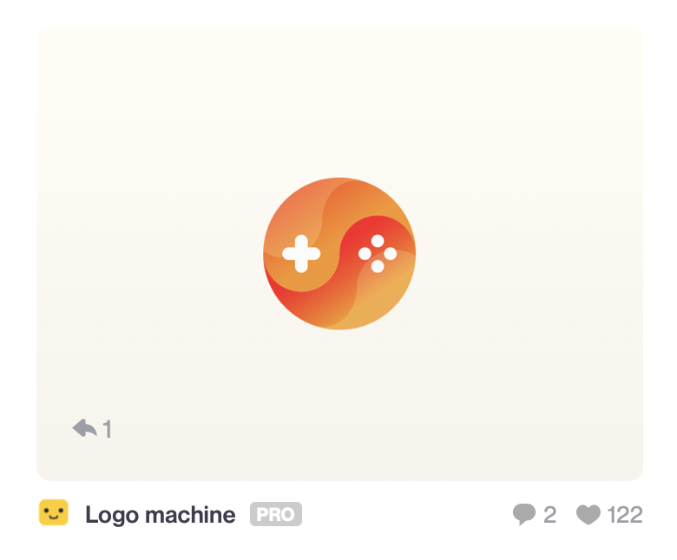
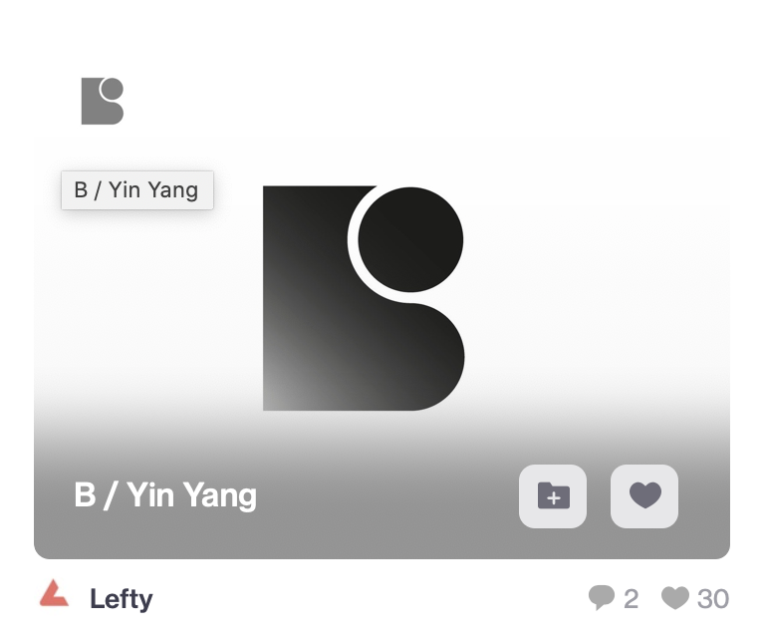

Slide 12




